Slide 1
How to Apply to College
October 2023

Slide 2
Get to know ontariocolleges.ca

Slide 3
www.ontariocolleges.ca
Notes:
Ontariocolleges.ca is the application service, we assist with the application process and transcript requests; colleges process applications and make decisions
Can walk through different parts of the website here, e.g. APPLY/LOG IN and Programs

Slide 4
New Application Cycle is Open!

Slide 5
Important Dates: Application Opens
Want to start college in September or January? Now is a great time to apply!
Application for September and January Intakes opens on October 1st
Includes up to 5 program choices (no more than 3 at any one college). No extra cost to make changes!
Notes:
Talk about transcript fees: 0 – 30 plus 5 fee

Slide 6
Summary of Important Dates
October: Application Opens
November 1: Earliest Offer Date
February 1: Equal Consideration Date
May 1: Deadline to Confirm Offer
June: Tuition Deposit Deadline

Slide 7
How to Apply Video
Notes:
Video is embedded from YouTube, click to play.

Slide 8
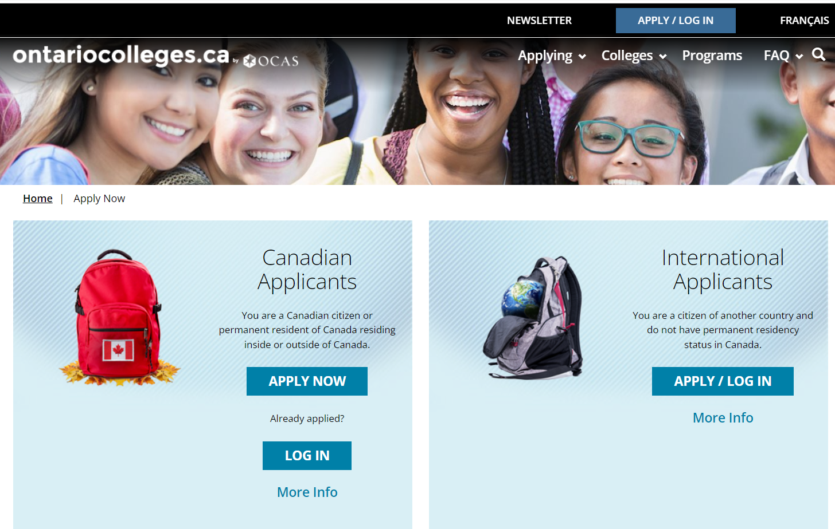
Application starts here!
Notes:
- Mention that each applicant can only have one active account; if they cannot remember their username and password, ontariocolleges.ca support can help!

Slide 9
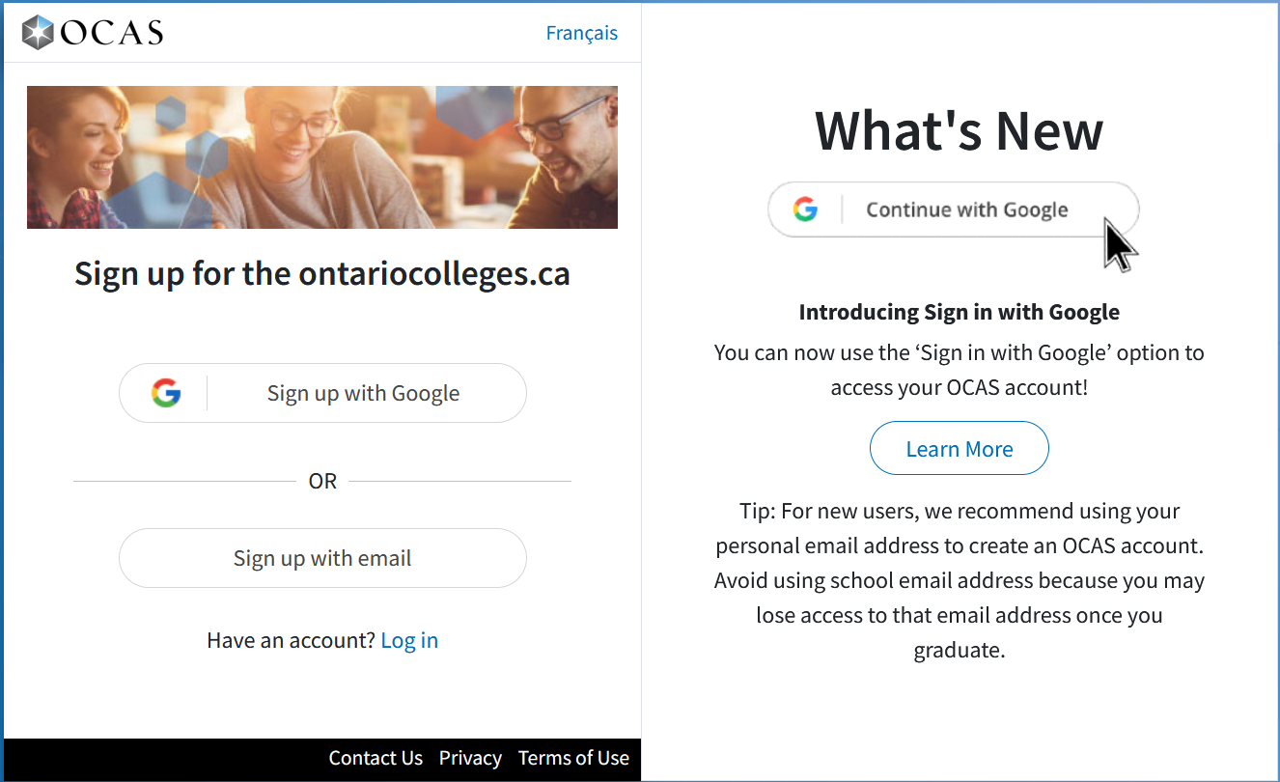
Sign up Options: Google or Email
Notes:
- Mention that each applicant can only have one active account; if they cannot remember their username and password, ontariocolleges.ca support can help!

Slide 10
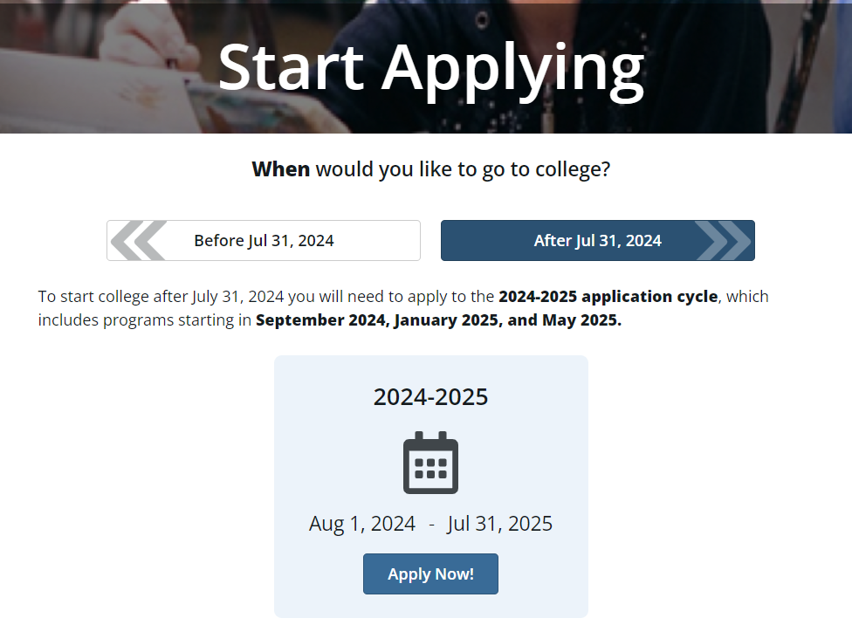
Start Application – Important! Select the correct cycle
Includes programs starting in:
September 2024
January 2025
May 2025
Notes:
Talk about application cycles
No refunds or transfers

Slide 11
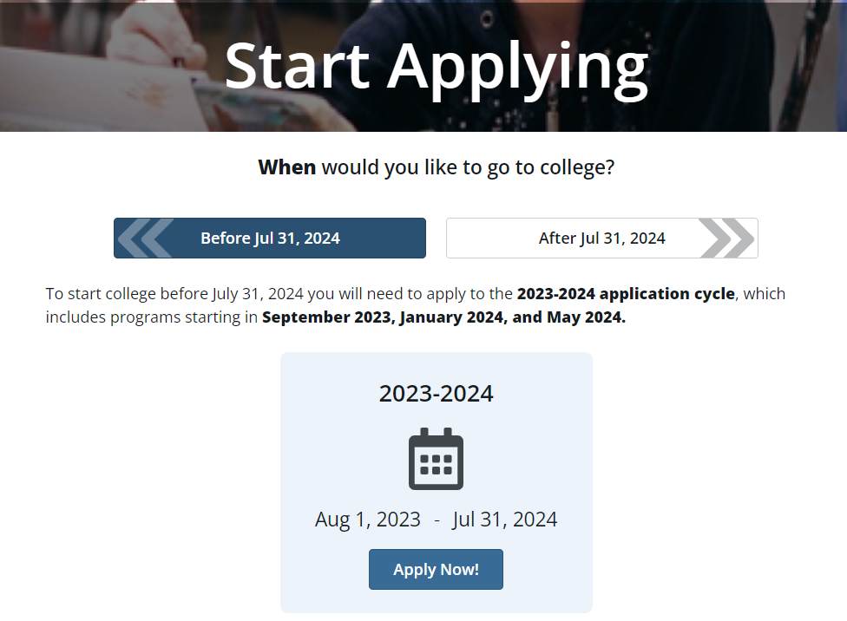
Start Application – Important! Select the correct cycle
Includes programs starting in:
January 2024
May 2024
Notes:
Talk about application cycles
No refunds or transfers

Slide 12
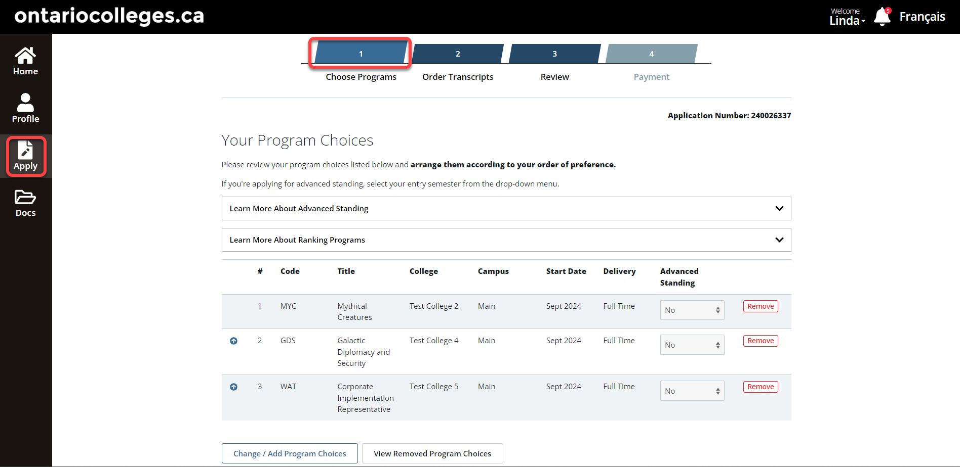
Choose Programs
Program choices can be updated
Change
Or Add
Notes:
- Can add up to 5 programs, with a max of 3 per college; talk about options (could all be different programs, or same program at different schools, etc), can add more program choices later (as long as within same application cycle) and can change program choices as needed

Slide 13
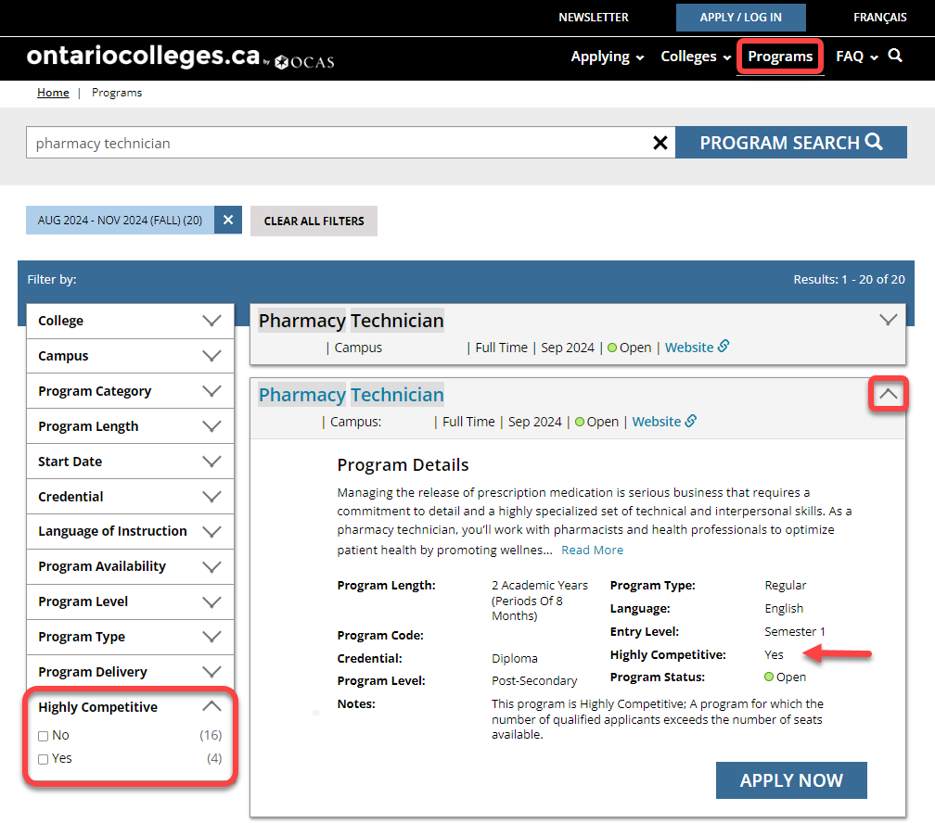
Program Search > Filters
Notes:
Highly Competitive programs mean’s that not everyone will be accepted. The deadline to apply to highly competitive programs is February 1

Slide 14
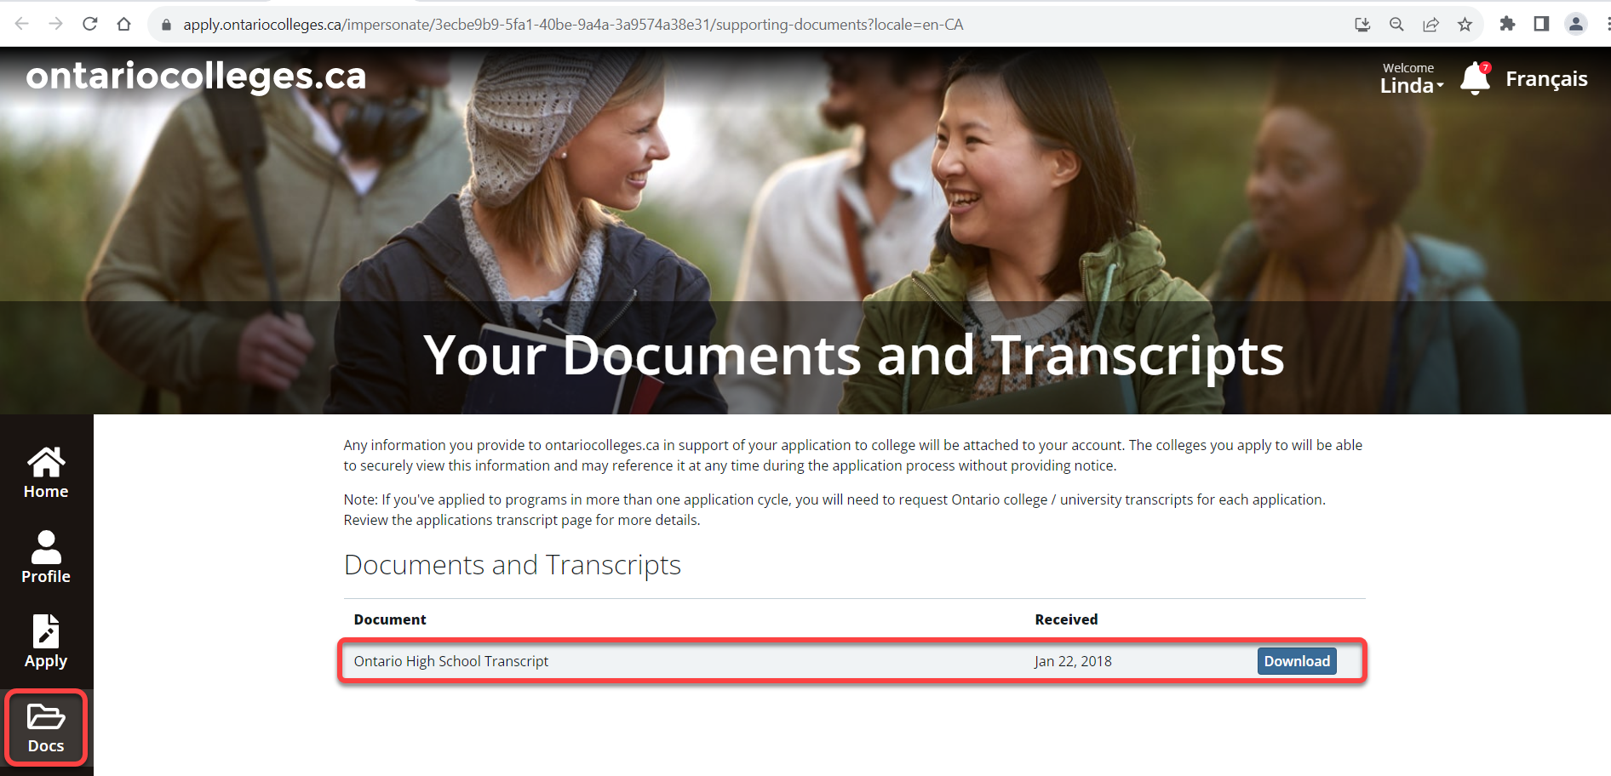
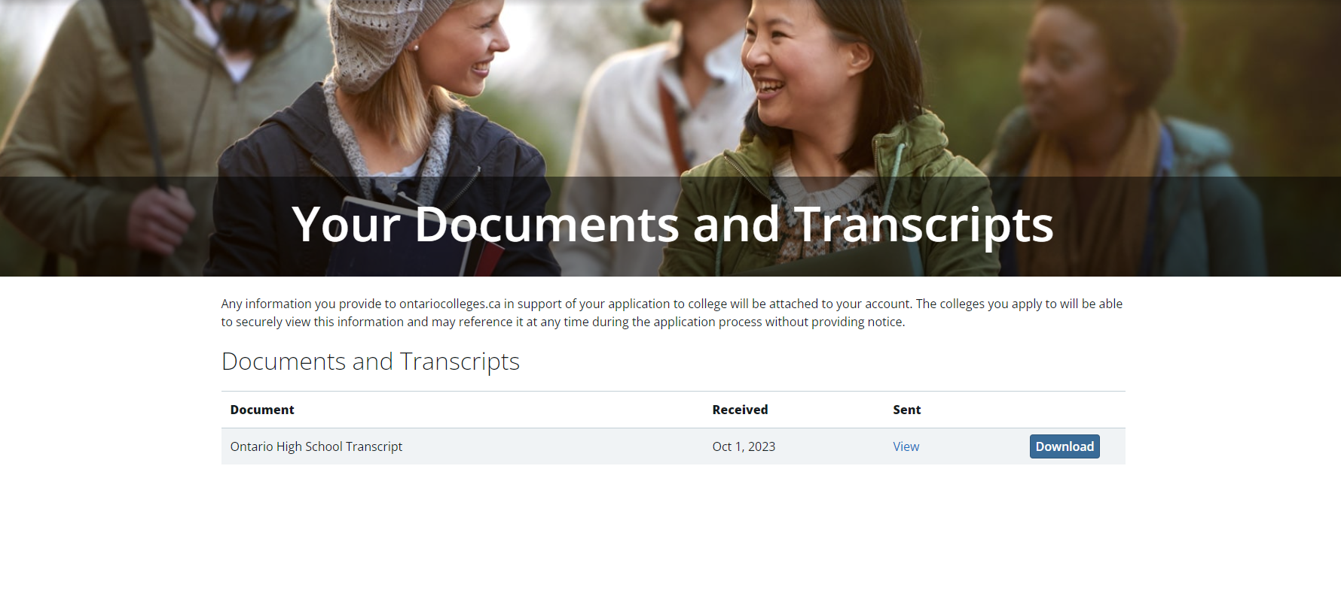
View Received Documents
Notes:
ICAS/WES
Any documents

Slide 15
Applying > Transcripts for Detailed Instructions
Notes:
ontariocolleges.ca has some resources on how to send your transcripts. You can find this page under the applying tab on the website.

Slide 16
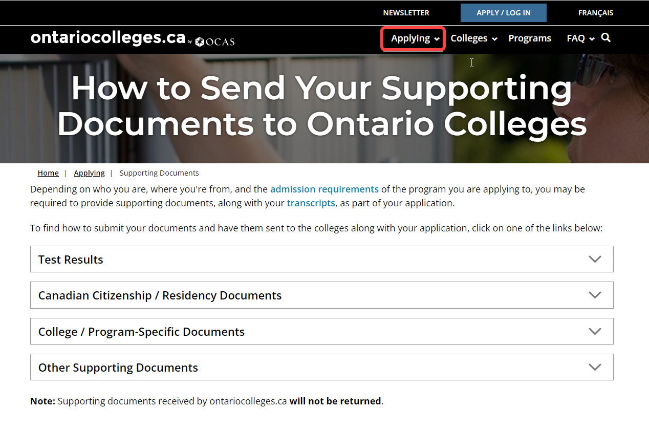
Applying > Supporting Documents
Notes:
ontariocolleges.ca has some resources on how to send your supporting documents. You can find this page under the applying tab on the website.

Slide 17
When will I receive an offer?

Slide 18
Important Dates: Offers of Admission
First date that colleges can release offers is November 1st
Offers continue to be released on an ongoing basis
Many offers for highly competitive programs are not released until February 1 or later
Check your application status in your College Portal accounts, or contact the college for clarification
Offers are posted in your ontariocolleges.ca account
Notes:
First date that colleges can release offers is November 1^{st;} Offers continue to be released on an ongoing basis; Many offers for highly competitive programs are not released until later in in the Spring of the following year; Check your application status in your College Portal accounts, or contact the college for clarification; Offers are posted in your ontariocolleges.ca account
- 1 – 2 day delay

Slide 19
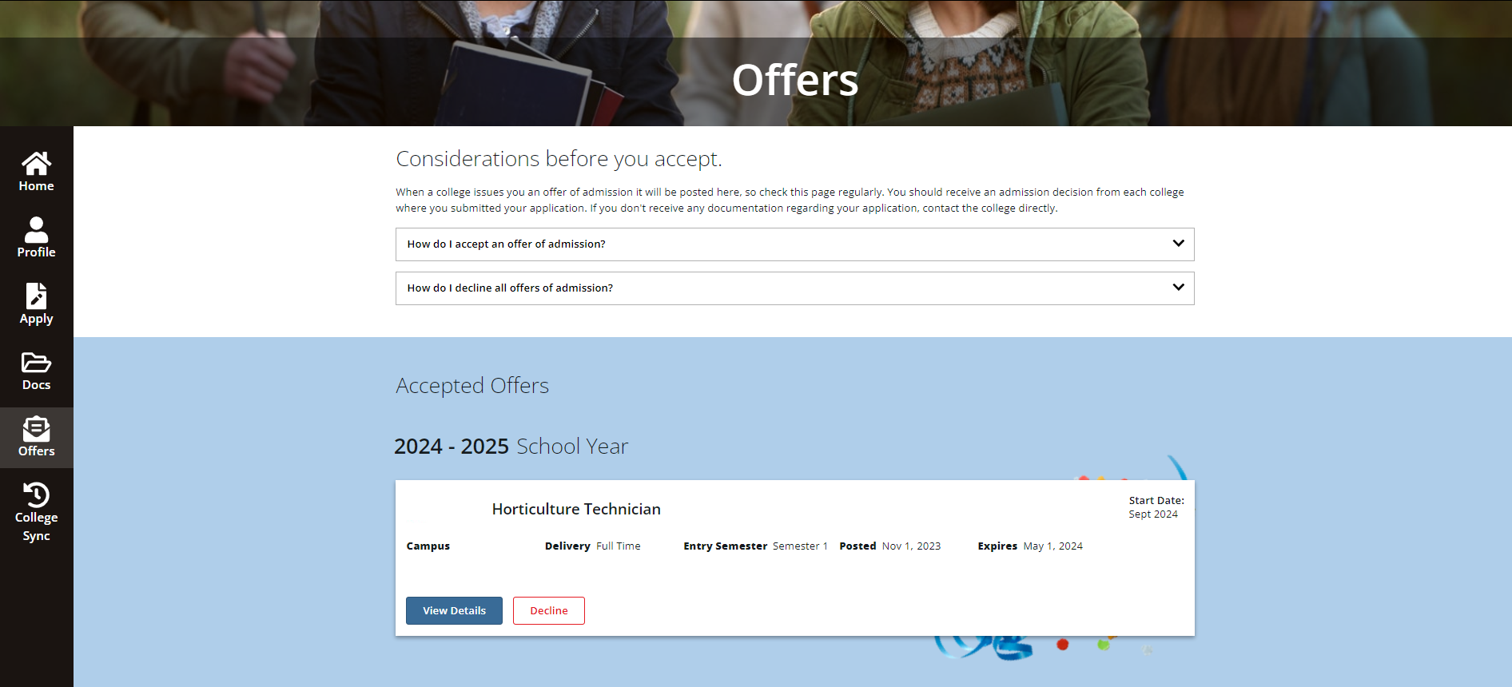
Offers
Notes:
Take note of expiry
(cannot change until following day)

Slide 20
Important Dates: Equal Consideration Date
Equal consideration date for highly competitive programs is Thursday February 1st
Plan to apply before Feb 1, to have the best chance of receiving an offer!
Some programs close on Feb 1, as they are already full
Many programs are available to apply to after February 1st
List of highly competitive programs accessed from this page. https://ontariocolleges.ca/en/apply/highly-competitive-programs

Slide 21
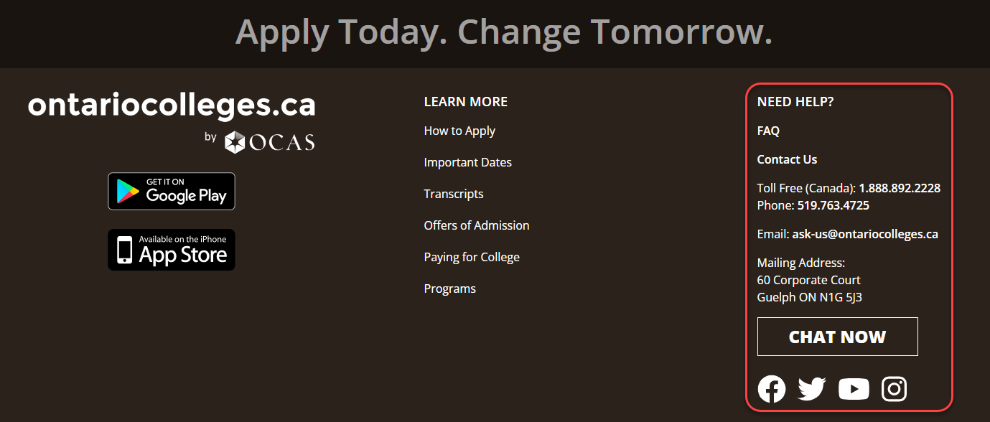
How can you reach OCAS?
Phone:
1-888-892-2228 (toll free)
519-763-4725
Email:
ask-us@ontariocolleges.ca
Live Chat
Notes:
If you scroll down to the bottom of any page of our website you can find this information.

Slide 22
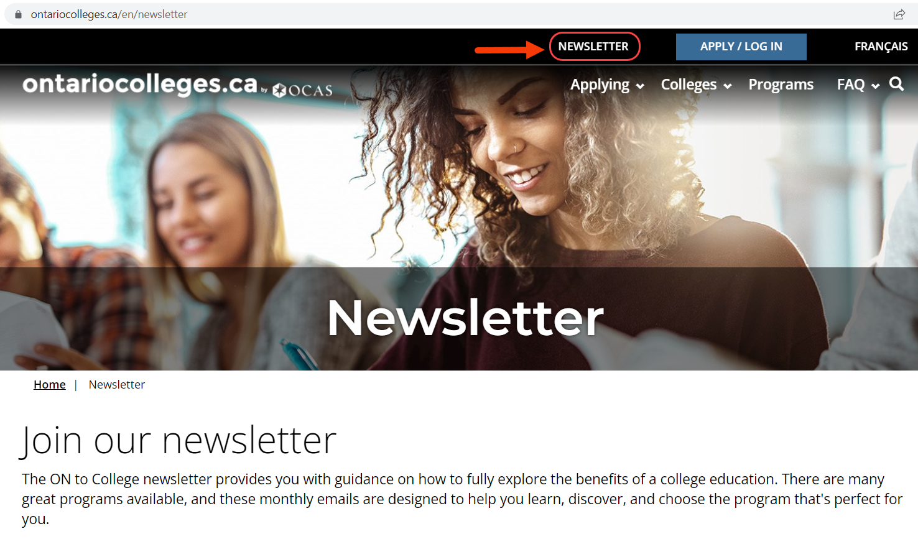
Stay in touch with our Newsletter!

Slide 23
Thank you!
Questions? ask-us@ontariocolleges.ca

